Slide 1
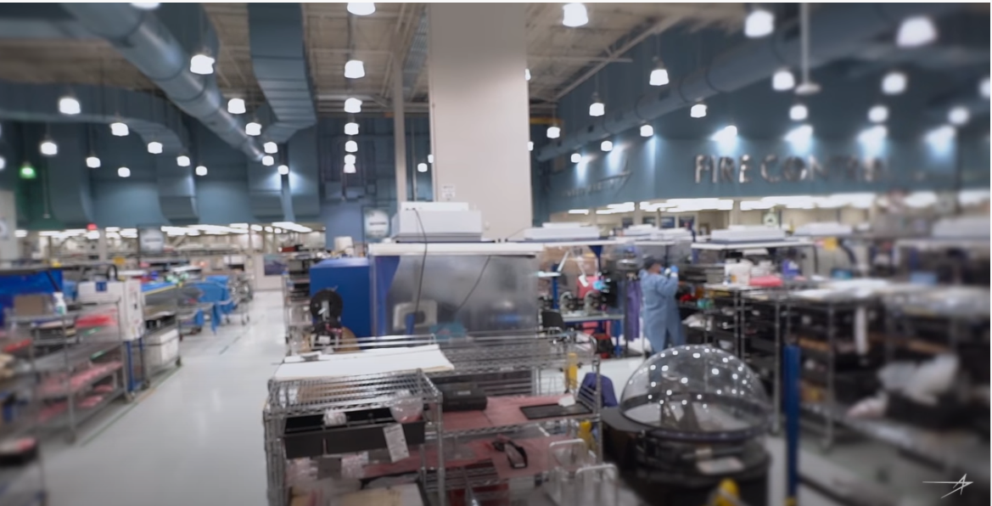
What is Manufacturing?
Click the image to watch video about manufacturing.
Image source: shutterstock.com
Source: Lockheed Martin
Write down three new things you learned.
Notes:
Overview of Workshop:
What is manufacturing (then and now)?
What kinds of things are manufactured today?
How do we manufacture products?
Why manufacturing? (Students explore manufacturing in CT)
Reflection (Students reflect on what they have learned)
Summary: Why Manufacturing?

Slide 2
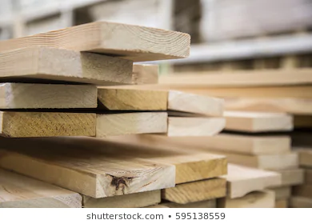
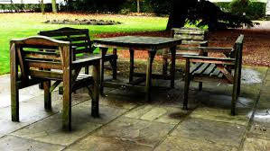
Manufacturing
Manufacturing is the process of turning natural (raw) and processed materials into products.
The products are made on a large scale. For example, 1000+ products made in a few hours or days.
.
Raw Material
Manufacture
Product

Slide 3
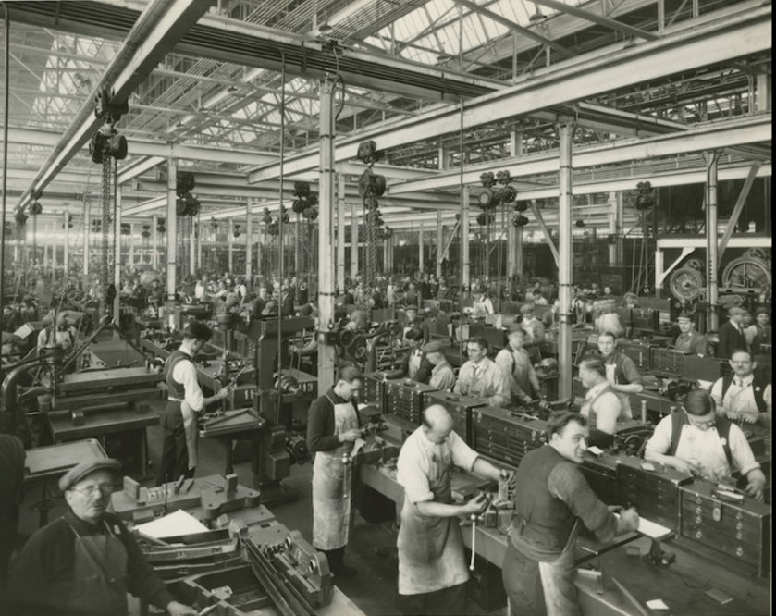
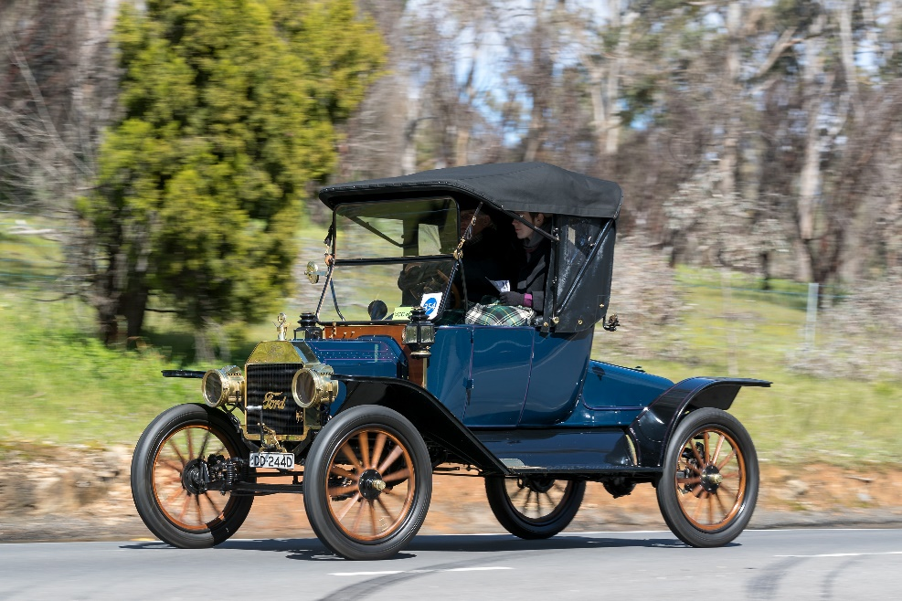
Early Manufacturing
1913
1913 Model T
Image source pbs.org
Image source shutterstock.com
Machines
Lots of People
Dark, dirty and dangerous
Notes:
The manufacture of products uses the assembly line process invented by Henry Ford in the 1900s to produce lots of cars at lower cost.
How are products manufactured? Machines and lots of people (in 1913, a Ford Model T plant had 14,000 people working there.
Three characteristics of early manufacturing? Early manufacturing was dark, dirty and dangerous.

Slide 4
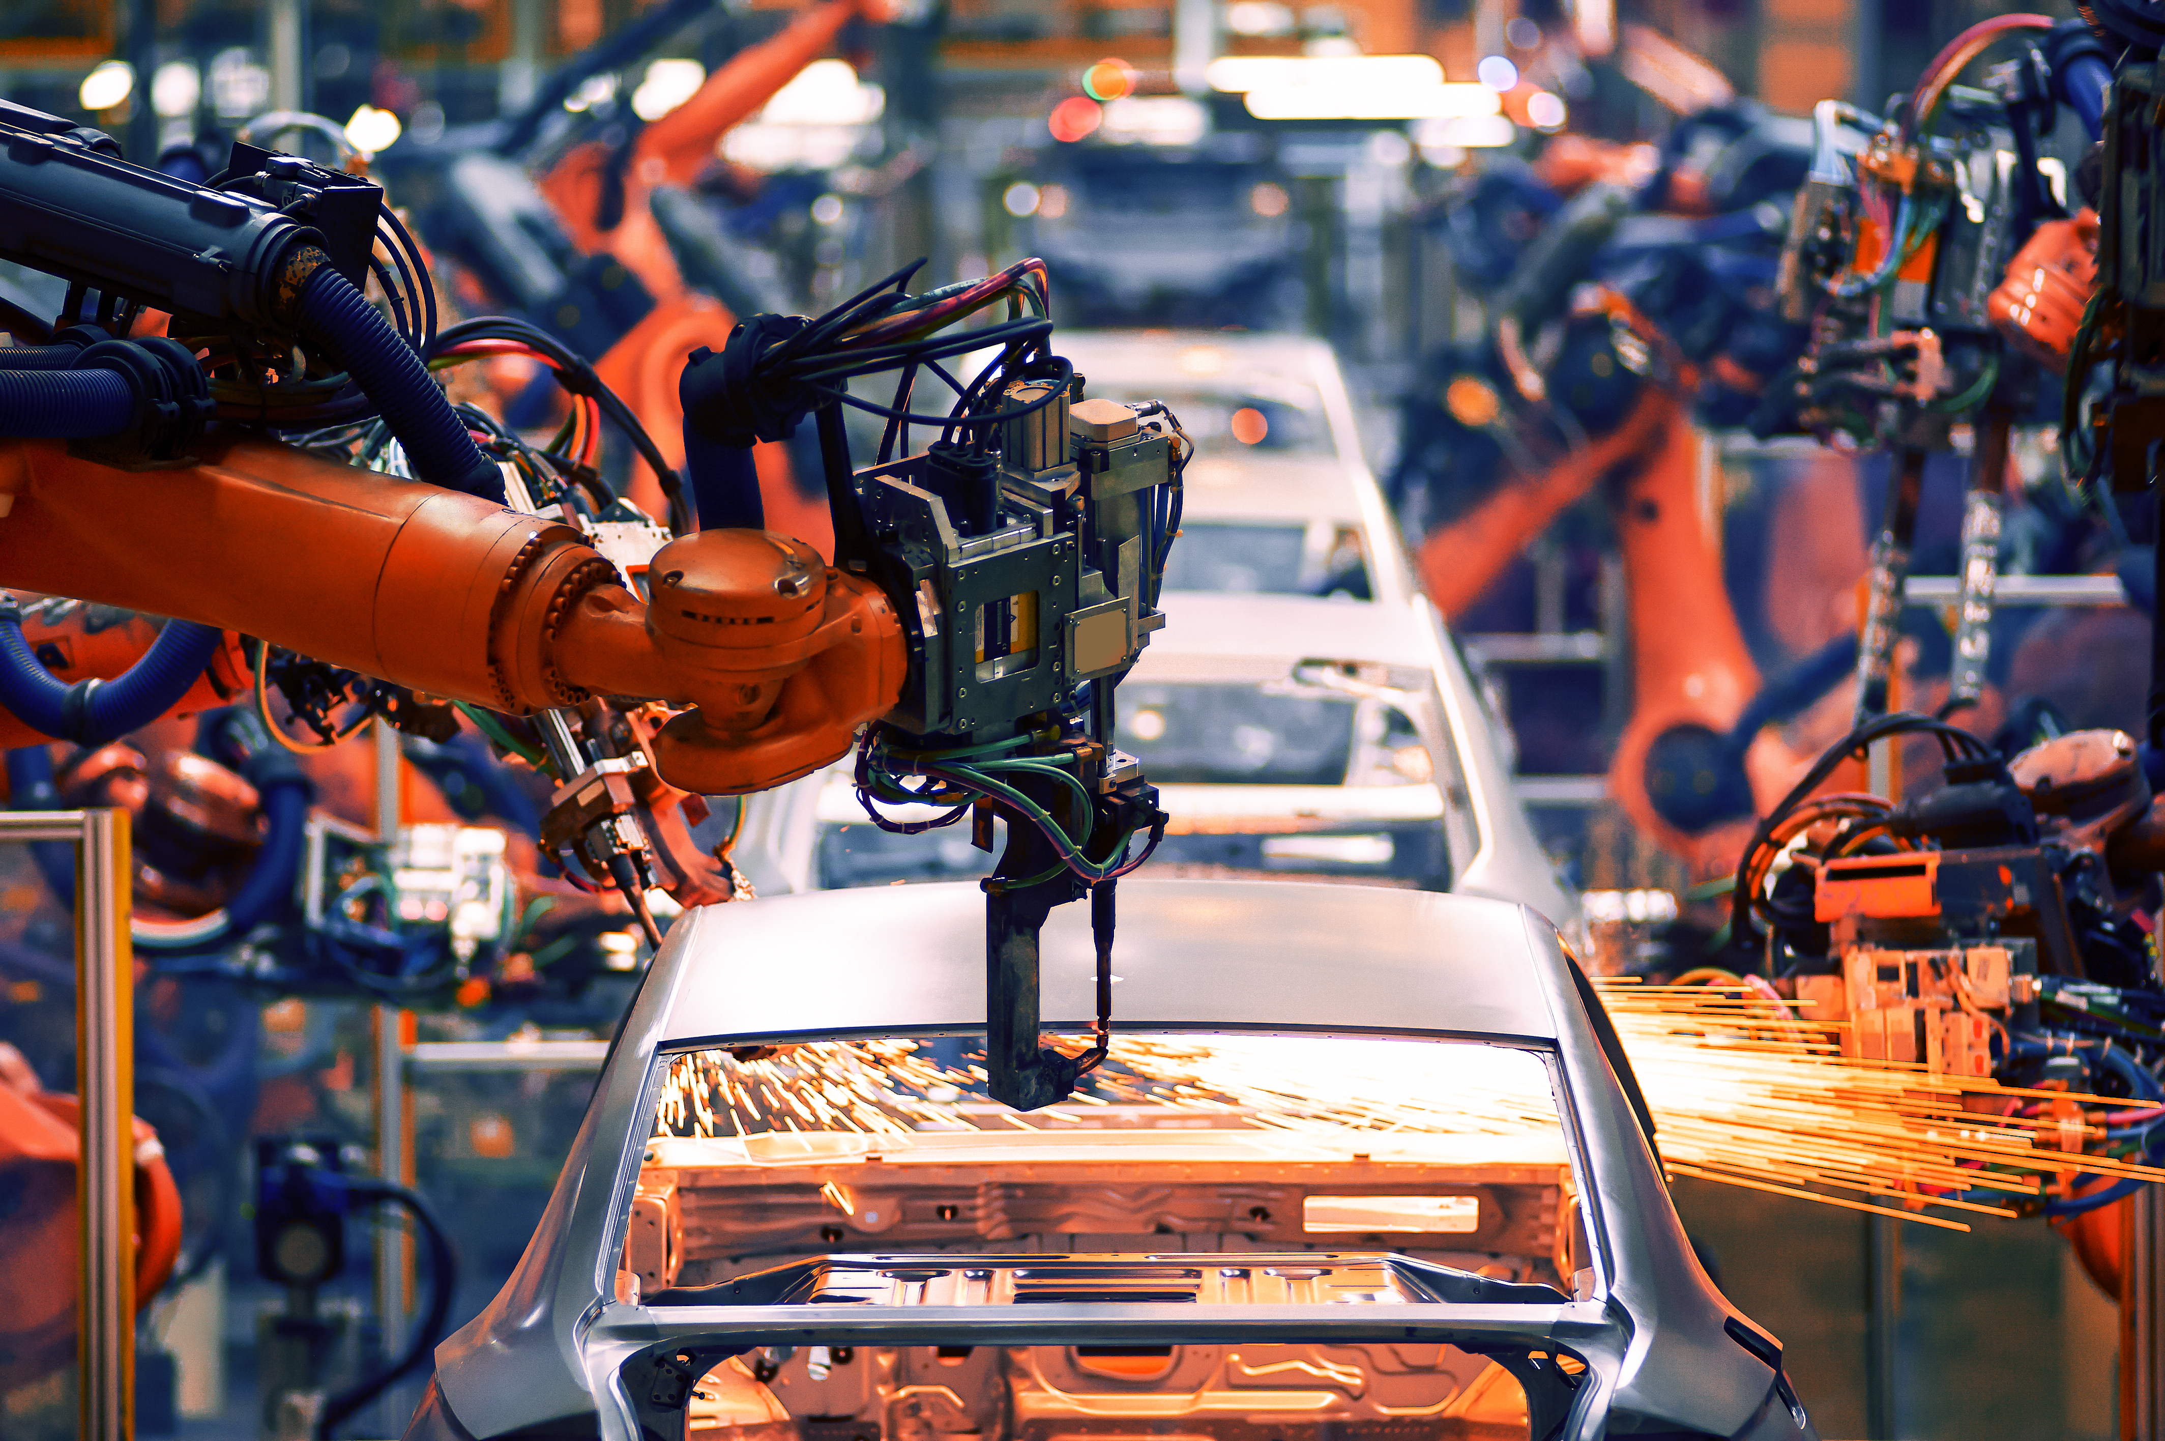
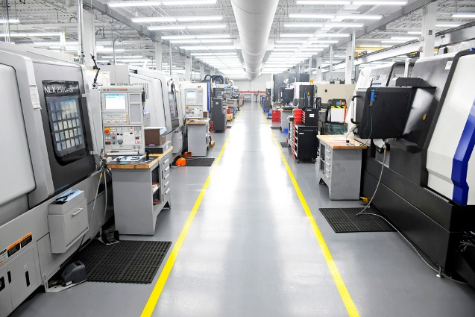
Advanced Manufacturing
Image source pbs.org
Phoenix Manufacturing, Enfield
Automated Machines and Robots
Less people making products
Cleaner and safer
Notes:
Manufacturing today, advanced manufacturing is different.
How are products manufactured?
Complex machines, Robots, Less people (500 assembly line workers at Ford Plant in MI).
Three differences between advanced manufacturing and early manufacturing?
Advanced manufacturing is cleaner, leaner (uses less raw materials and less people) and greener (does less harm to the environment).

Slide 5
Advanced Manufacturing in CT
Chemicals
Sustainable Energy
Plastics
Food & Beverage
Photo by Crystal Kwok on Unsplash
Photo by Nicholas Doherty on Unsplash
Photo by Wepco Plastics
Photo by Monique Carrati on Unsplash
Photo by ZMorph Multitool 3D Printer on Unsplash
Machinery
Electronics & Computer
Metals & Finishing
Aerospace & Transportation
Photo by Blaz Erzetic on Unsplash
Photo by Michal Jarmoluk from Pixabay
Photo by Kelly Lacy from Pexels

Slide 6
Made in Connecticut Challenge
Match a product card with a company description card
Sikorsky Aircraft
Stratford, CT
Manufactures: Helicopter parts
Fun Facts:
Sikorsky has produced Presidential helicopters since 1957.
Sikorsky manufactures Black Hawk helicopters for military use.
Aerospace and Transportation

Slide 7
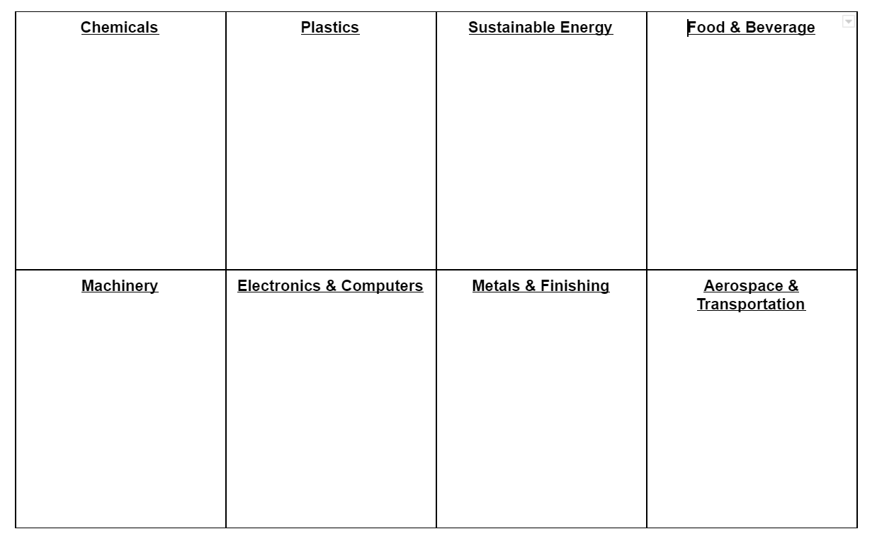
Manufacturing Sorting
Write down the name and product of each manufacturing company in the category where they best fit

Slide 8
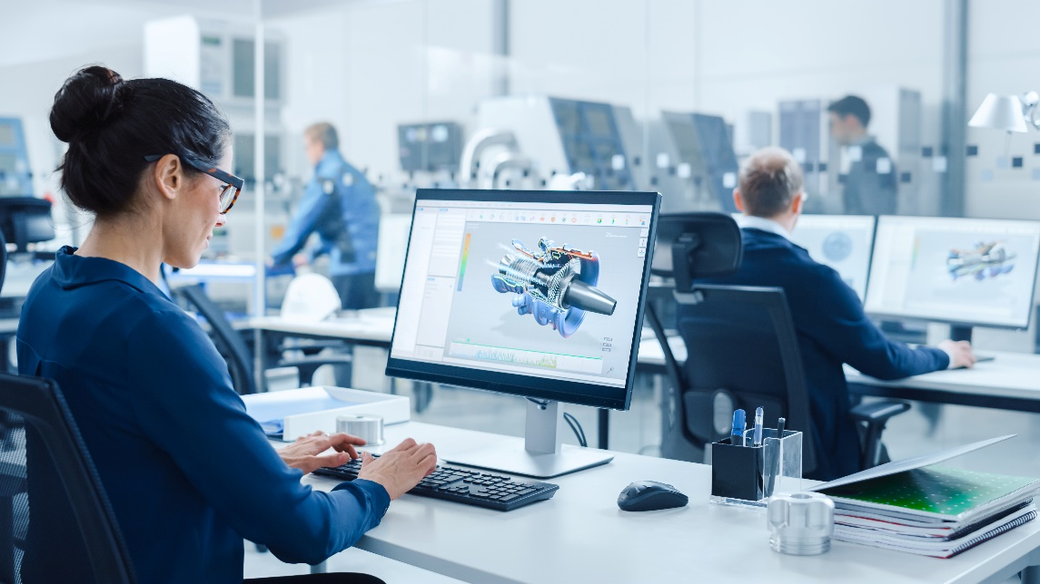
Reflection
Write/Share one new thing you learned about manufacturing
Source: Shutterstock.com
Source: Shutterstock.com
Notes:
Ask students the following questions as they share:
Three differences between early and advanced manufacturing?
Three new things I learned about manufacturing?
Two things I want to learn more about in manufacturing?
Why do people want to work in manufacturing?

